Slide 1
Algorithmic Trading
DSO 530 Final Project
Hung-Li Chuang | Justin Feng | Yiting Hu | Qiongqiong Lin | Shui Yu
Notes:
Good evening classmates and professor Tong,
We are group 10, my name is Yiting Hu and my team members are Hung-li Chuang, Justin Feng, Qiongqiong Lin, and Shui Yu. We are excited to be here to present our project on Algorithmic Trading to you guys.

Slide 2
Agenda
Summary of Problem
Data Preparation
Train/Test Split
Sliding Window
Prediction Model
Model Introduction
Feature Selection
Prediction
Trading Strategy
Buying/Selling Strategy
Results
Conclusion & Future Work
Notes:
Here’s an overview of our presentation. We’ll first let you know the background and mission of our problem. Then we’ll walk you through the process of data preparation, what our prediction model is and how it works, the trading strategy we employed and the results. Lastly, we will conclude the presentation with future work.

Slide 3
Summary of Problem
Principal $1,000,000
Time Day 505 to Day 756 (251 days)
Goal
Maximize cash owned at the end of Day 756
Maximize sharpe ratio
Maximize the number of profitable days
Data
Daily stock data of 50 companies from SSE 50 index from Day 1 to Day 756
10 common stock features
Assumptions
Risk-averse psychology
Only use past data to predict future
Notes:
Diving into the summary of the problem. We are a team of financial analysts who are trying to enter the market with 1 million cash.
We have the daily stock data from the past and 10 common stock features derived from these data. We worked to build a stock price prediction model for each stock, then based on our trading strategy, we will take corresponding actions.
Our project is based on 756 days horizon. We will start trading on the day of 505 and continue til day of 756. Our goal right here is to maximize cash owned by the end of the last day. We will also measure our success by Sharpe Ratio and the number of days that we gained profits.
Now that our background problem is clear, let’s get right into the subject. I’ll hand to my colleague Shui, she will talk about the data preparation part.

Slide 4
Data Preparation
Raw Data
Engineered Features
 | open | high | low | close | volume | volumelag | ... | PROClag
Day 17
...
Day 504
Day 505
...
Day 756
Step 1
For each stock, join raw data and engineered features
Drop the variable volume
For each day, use today’s closing price as target y and all the features before today as independent variables X
Figure 1. The result data after step 1
Notes:
To prepare our data ready to use, we conduct three preprocessing steps.
First, to include all variables at hand, we join raw data and engineered features for each stock. We drop the variable volume and instead include volumelag in our variables.
For each day, we want to predict the closing price, so we use today’s closing price as our target y, and use the data before today as independent variables X.

Slide 5
Data Preparation
Normalized
Step 2
Normalize the independent variables to bring them to the same range
Step 3
Split data at Day 505
Use data until Day 504 to train and test the model
Use data after Day 505 to do predictions
 | open | high | low | volumelag | ... | PROClag | close
Day 17
...
Day 504
Day 505
...
Day 756
Train and Test
Predict
Figure 2. The result data after step 2 and step 3
Notes:
Then, we notice that our variables are in different ranges. For example, volumelag is in much larger scale than other variables. So we normalize the data to bring variables to the same range.
Finally, since we will start trading at Day 505, this means that since then, we won’t be knowing the data until the current trading day. So we split data at Day 505, and we use the data before that to train and test our model. The data after that will only be used when we do predictions.

Slide 6
Train/Test Split
Use 0.8 as train/test split ratio
Training Set
Day 17 to 419 (403 days)
Test Set
Day 420 to 504 (84 days)
 | open | high | low | volumelag | ... | PROClag | close
Day 17
...
Day 419
Day 420
...
Day 504
Training Set
Test Set
Trading Period
Figure 3. The obtained training and test set
Notes:
As mentioned just now, we use day before Day 505 to train and test our model. We set the train/test split ratio to be 0.8 and divide the data into two parts. Thus, we have day 17 to 419 as the training set and day 420 to 504 as the test set.

Slide 7
Sliding Window
 | open | high | low | volume | volumelag | ... | PROClag | close
Day n
Day n+1
...
Day n+14
Day n+15
Use sliding window to gather input data
Use information of the past 15 days to predict the closing price on the 16th day
X
y
Figure 4. One of the sliding windows and its corresponding X and y
Notes:
Due to the intrinsic property of our model, which will be discussed later, we are able use sliding window to gather the input data of our model. We create sliding windows with size of 16 days. Information of the past 15 days will be used to predict the closing price on the 16th day.
Here, the figure shows the example of one sliding window. Supposing we want to predict the closing price y on Day n+15, we use the grey cells as Xs to fit our prediction model.
Now, we have prepared our data ready to be used as the input of our model. Next, Justin will introduce our model in detail.

Slide 8
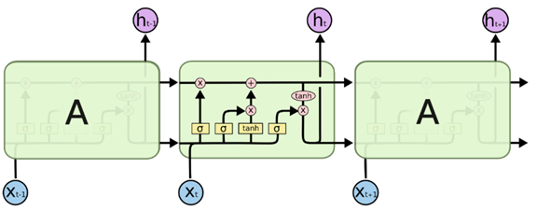
Model Introduction
Long Short Term Memory (LSTM) model
Work with time-series data
Learn long-term dependencies
Regulate the transfer of information by “gates”
Figure 5. LSTM structure example
Notes:
To predict the closing price using the past data, we’ve tried several models and the model we use for evaluation is the LSTM model.
The long short term memory is a special kind of recurrent neural network that capable of learning long-term dependencies and is good at working with time-series data.

Slide 9

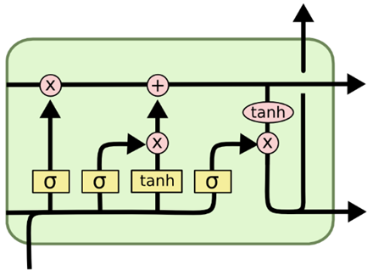


Model Introduction
output
Cell state
(information)
: sigmoid function (Gates)
output
(to the next cell)
input
Notes:
In the LSTM structure, each green block serves as a cell in LSTM and will not only get information from the input but also from previous cell that passes on the historic information.
The model can choose whether to keep the previous information and add important message from recent input by regularizing through the sigmoid function, or called the gates. The “forget gate” determined which information from previous cell is important to pass on and the “input gate” is for regularizing the input detail.

Slide 10
Feature Selection
Backward selection
Use Mean Absolute Error(MAE) as the loss function
Drop off MA15lag and day15Return to reach the lowest test MAE
Final Features
open, high, low, volume, fastKlag, ADlag, OBVlag, MA5lag, day5Returnlag, PROClag, close(before today)
Notes:
After building the model with all of the features, we want to improve our model performance by conducting feature selection process.
To evaluate our model, we choose mean absolute error, the MAE, to be our evaluation metric. We adopt backward selection to select features, which means that we start with all variables and then eliminate one variable at a time, and select the feature combination with the lowest test MAE. The result of backward selection is that we decide to drop 15-day moving average lag and 15-day return.
Then, we use our final model to do predictions.

Slide 11
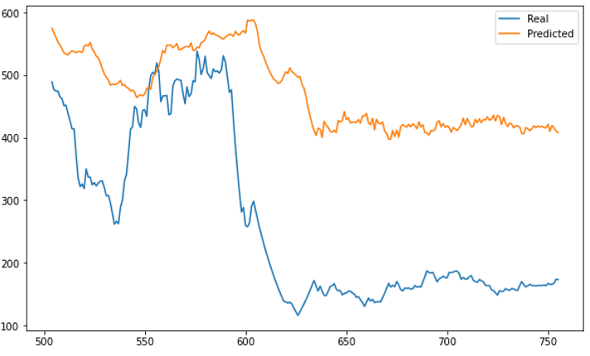
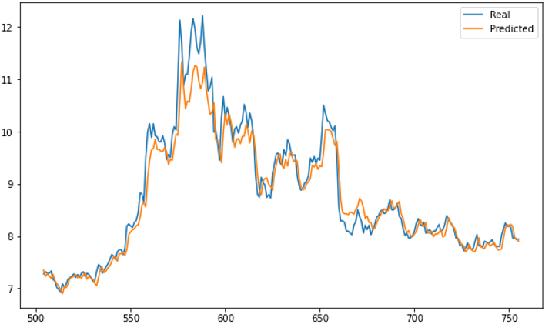
Prediction Results
Notes:
As we were simulating the trading, we also look at the performance of the prediction. While we expect the model would be good at working with time series problems to learn some patterns or rules well from the data, the results show that we still have a long way to improve as some of the prediction is quite biased and some of the prediction tends to follow the latest price which reasonably giving the lowest loss scores that the model is learning.
Next, Andrew will talk about our trading strategy and the evaluation of the three metrics.

Slide 12
Trading Strategy
Buying
Tomorrow’s predicted price > Today’s closing price
Tomorrow’s predicted price > Today’s predicted price
%K > %D
Selling
Take Profit Point : 30%
Stop Loss Point : -3%

Slide 13
Results
Profit: $ 93225
Sharpe Ratio: 0.918
Days Making Profit: 126 Days

Slide 14
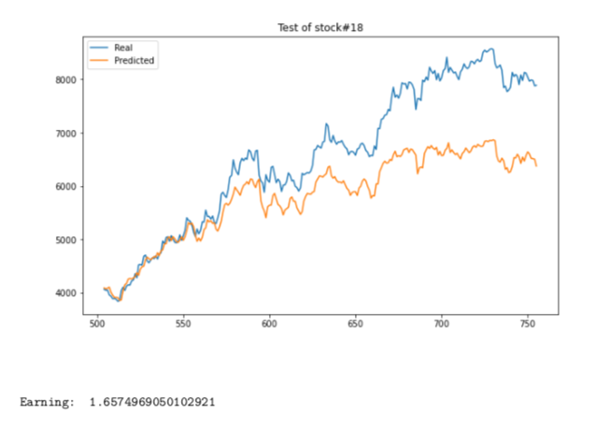
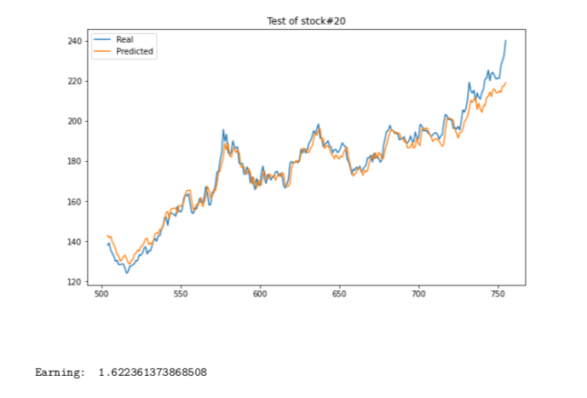
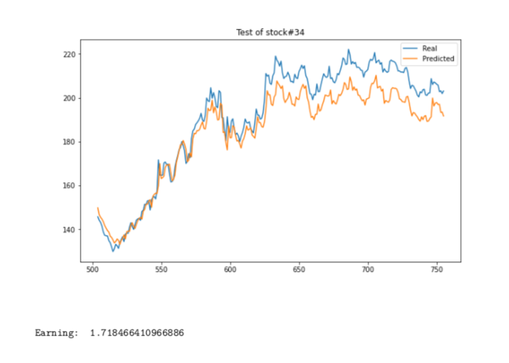

Slide 15
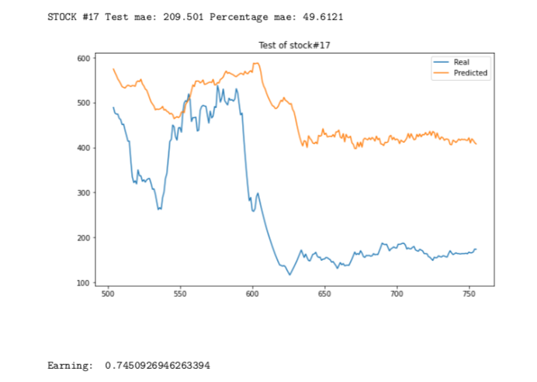
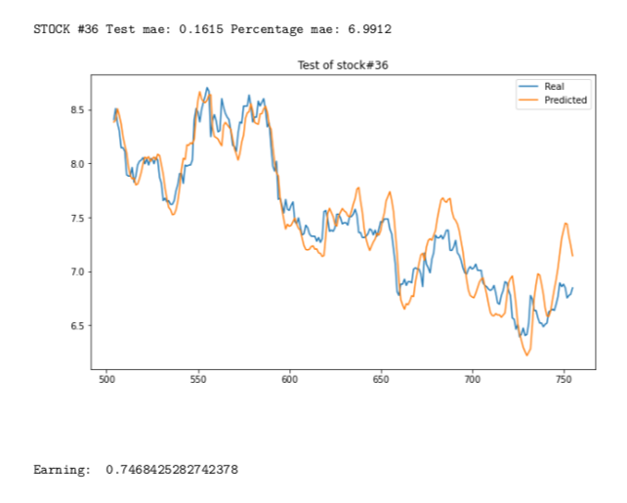
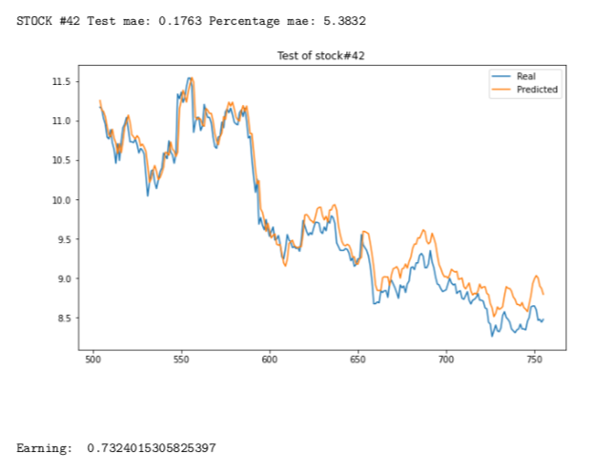

Slide 16
Conclusion
In order to maximize the stock investment returns
Preprocessed data and used sliding window to gather input data and conducted backward selection to select features
Built Long Short Term Memory(LSTM) model to train and predict stock closing price
Set up trading strategy to select most profitable stocks and calculate the investment returns we will have

Slide 17
Future Work
Try different investment portfolios according to variation and correlation of different stocks to find a better portfolio
Build new and robust models for long-term investment with creating new variables and new target y
Improve trading strategy, for example, set up new trading strategy according to long-term investment model instead of only taking stop-loss and take-profit into consideration

Slide 18


